Slide 1
Structured Text
Timers
© 2022John Sefcovic and Oakland Community College.

Slide 2
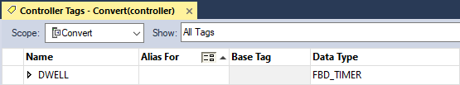
TIMER ON RESET
Studio 5000
The Timer On optional Reset (TONR) is an Energize Timer instruction.
The TONR (all Timers) use the Data Type FBD_TIMER.
Function Block Diagram programming was developed before Structured Text and rather than developing additional Data Types FBD data is used.

Slide 3

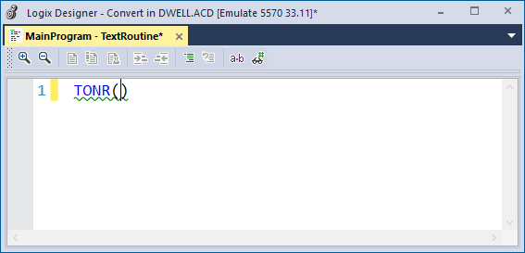
TIMER ON RESET
Studio 5000
The TONR is in the Timer/Counter tab in the Instruction Palette and is dragged into the Editor.

Slide 4
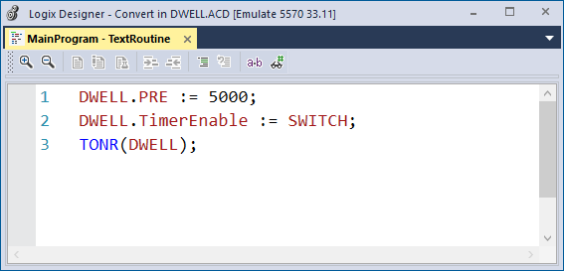
TIMER ON RESET
Studio 5000
Once the Tag has been assigned to the TONR, the Preset .PRE and TimerEnable may be assigned by the instruction but is not required.
Different from timer en

Slide 5
TIMER ON RESET
Studio 5000
The TagName.TimerEnable is the condition which causes the Timer to elapse.

Slide 6
TIMER ON RESET
Studio 5000
Timer value formats.
DWELL.PRE
DWELL.ACC
Timer status bit formats.
DWELL.EN
DWELL.TT
DWELL.DN
DWELL.EnableIn
If cleared, the instruction does not execute, and outputs are not updated. If set, the instruction executes. Default is set.
DWELL.Reset
Request to reset the timer. When set, the timer resets and clears EN, TT and DN and sets ACC = 0.
There are additional bit and a word outputs on the operational status of the FBD Timer Data Structure.

Slide 7
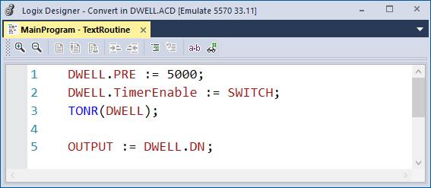
TIMER ON RESET
Studio 5000
Energize Timer to Delay On, simple structure.

Slide 8
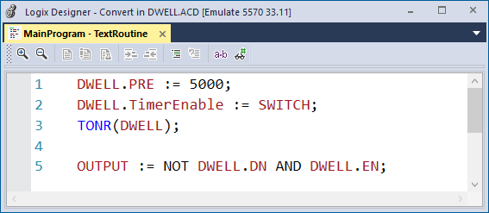
TIMER ON RESET
Studio 5000
Energize Timer to Delay Off, simple structure.
Uses the NOT keyword.
AND’d with the .EN so that the controlled Output is On when the TimerEnable is On.

Slide 9
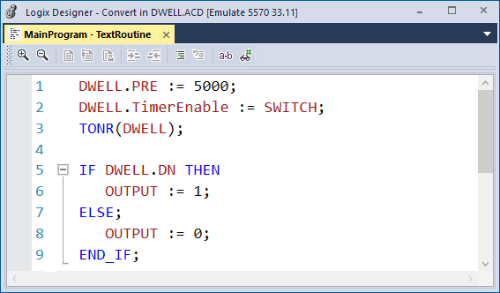
TIMER ON RESET
Studio 5000
Energize Timer to Delay On with an IF structure.

Slide 10
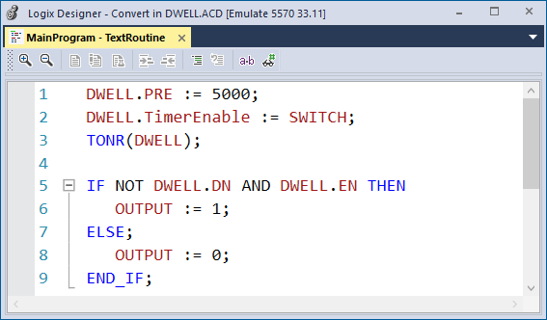
TIMER ON RESET
Studio 5000
Energize Timer to Delay Off with an IF structure.
Uses the NOT keyword.
AND’d with the .EN so that the controlled Output is On when the TimerEnable is On.

Slide 11
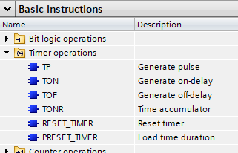
TIMER ON
Siemens
The Timer On (TON) is an Energize Timer instruction.
The TON is in the Timer operations folder and is dragged into the Editor.

Slide 12
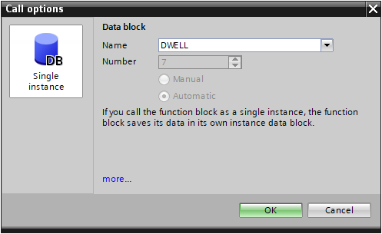
TIMER ON
Siemens
A dialog opens when the TON instruction is dragged into the program, the tag name in this example is DWELL. The TON is a System block and Program resource.

Slide 13
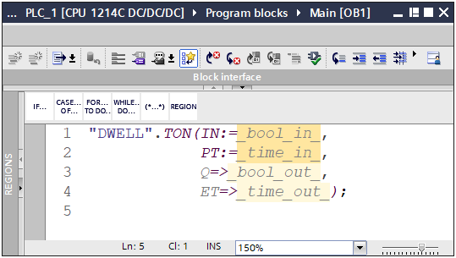
TIMER ON
Siemens
The TON is added to the program.
Required elements:
IN:=
PT:=
Optional Elements
Q=>
ET=>
The Optional Elements are to assign an alternative Tag Name to the default Q output and ET value.

Slide 14
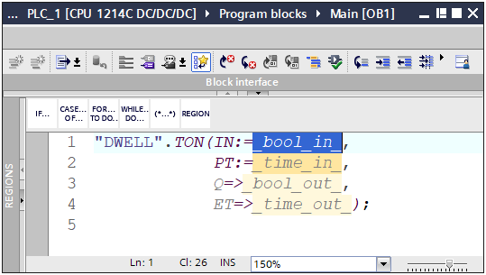
TIMER ON
Siemens
Double left click to select the IN: Tag element.

Slide 15
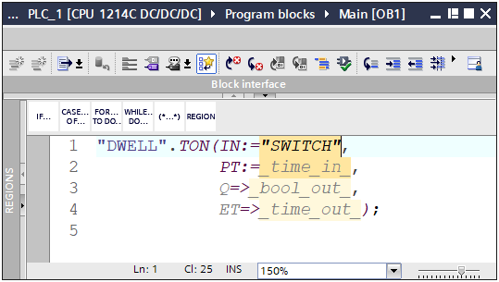
TIMER ON
Siemens
Type in the quotation mark and select the Tag from the Tag Listing.

Slide 16
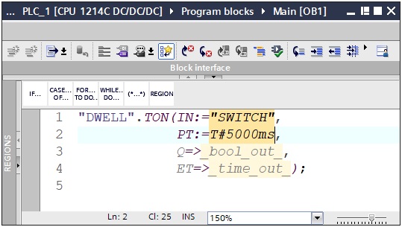
TIMER ON
Siemens
Double left click to select the PT: element. Type in the value.
Format
T# - Time Data Type
ms – Unit
T#valuems
Light yellow are optional

Slide 17
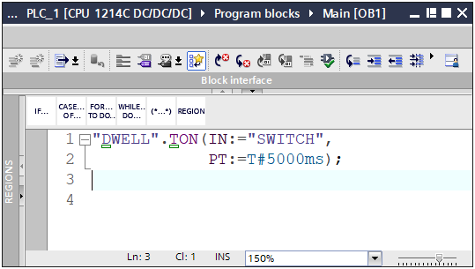
TIMER ON
Siemens
If not using the optional elements, press ENTER and elements are removed.
Cursor must be located after the Time Unit.

Slide 18
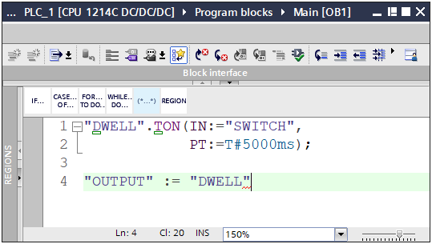
TIMER ON
Siemens
To enter a Timer Tag type in the quotation mark and select the Tag from the Tag Listing.

Slide 19
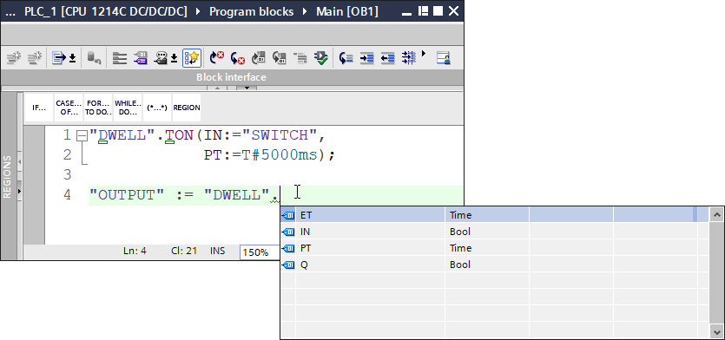
TIMER ON
Siemens
You MUST do this step.
Then type in a period . to popup the Tag Listing.

Slide 20
TIMER ON
Siemens
Timer value formats.
“DWELL”.PT
“DWELL”.ET
Timer status bit formats.
“DWELL”.IN
“DWELL”.Q

Slide 21
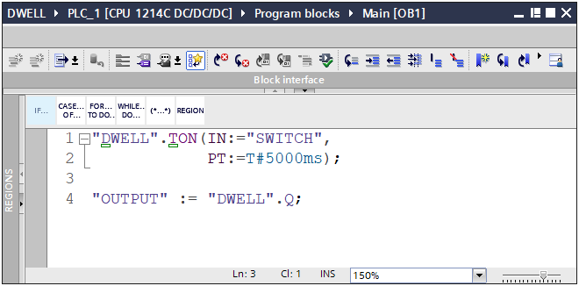
TIMER ON
Siemens
Energize Timer to Delay On, simple structure.

Slide 22
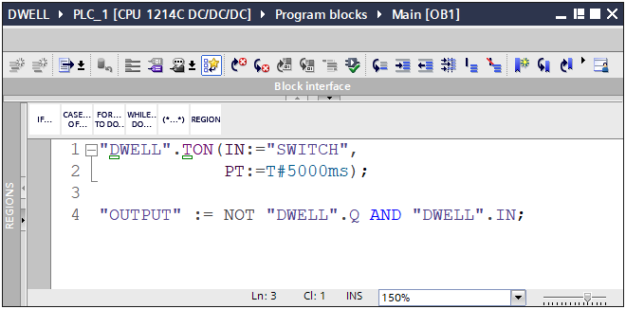
TIMER ON
Siemens
Energize Timer to Delay Off, simple structure.
Uses the NOT keyword.
AND’d with the .IN so that the controlled Output is On when the TimerEnable is On.

Slide 23
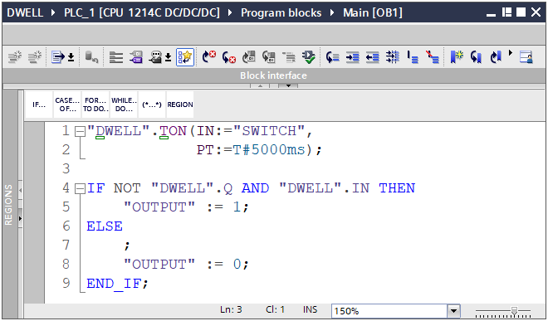
TIMER ON
Siemens
Energize Timer to Delay On with an IF structure.

Slide 24

TIMER ON
Siemens
Energize Timer to Delay Off with an IF structure.
Uses the NOT keyword.
AND’d with the .IN so that the controlled Output is On when the TimerEnable is On.

